Slide 1
SQL Database Projects – now in SSMS!
@ErikEJ

Slide 2
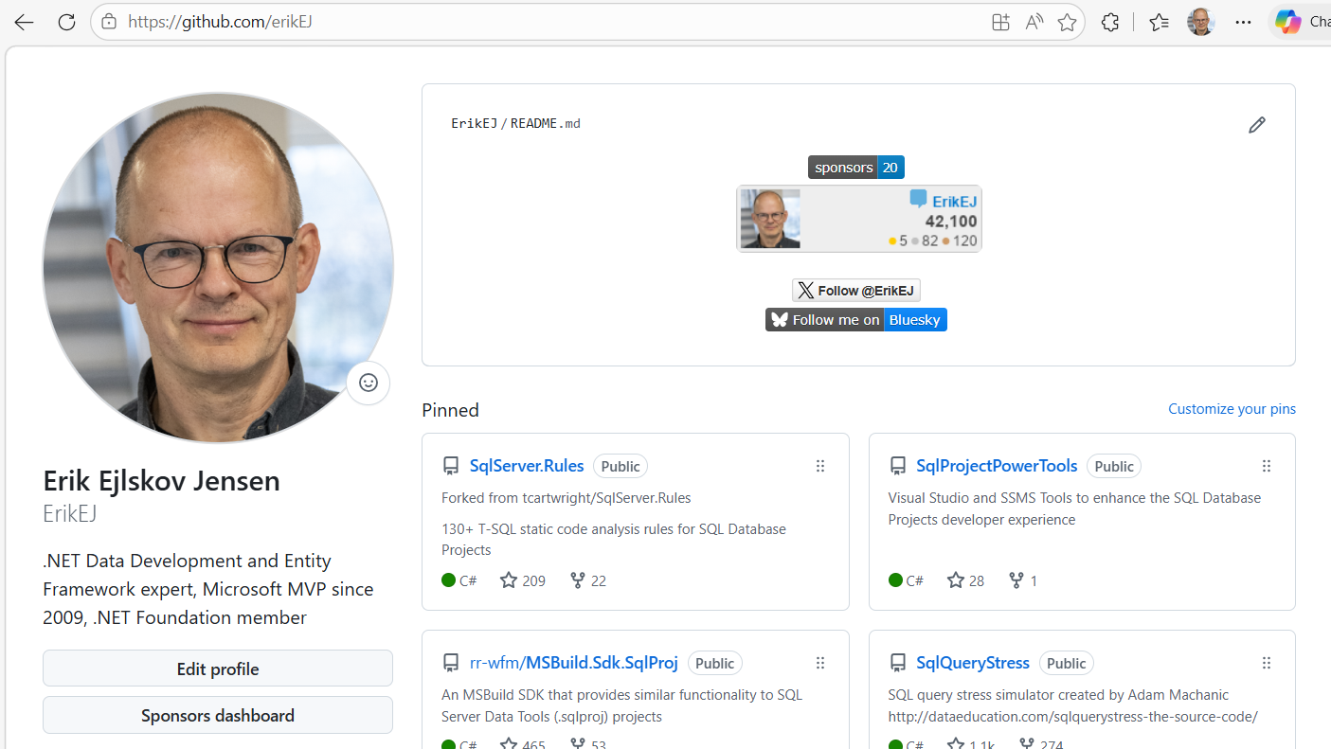

Slide 3
Why?
Database schema not in source control
Complex scripts to update schema
Versioning of database vs app a nightmare
Runtime errors in database due to uncaught syntax errors
No standard approach to naming or other database design ”business rules”
No qualified review of schema design
No cross platform build and deployment support
No proper NuGet integration

Slide 4
Process
Create .sql scripts
Build & Analyze
.dacpac
Deploy
Create .sqlproj

Slide 5
Process
Tooling
Authoring
Building
Deploying

Slide 6
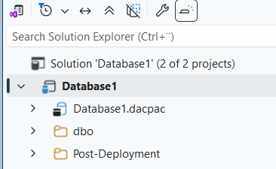
Tooling – now in SSMS
Import from Database
Set properties
Author
Publish

Slide 7
Process
Create .sql scripts
Build
.dacpac
Deploy
Create .sqlproj

Slide 8
Tooling
Enable and install in SSMS
Demo – project creation

Slide 9
Process
Create .sql scripts
Build
.dacpac
Deploy
Create .sqlproj

Slide 10
Authoring
SSMS .sqlproj
Demo (import, properties, build)

Slide 11
Process
Create .sql scripts
Build & Analyze
.dacpac
Deploy
Create .sqlproj

Slide 12
Adding SQL Project Power Tools to the mix
Acquire and install (github/erikej)
Demo – download and install

Slide 13
Building
Cross platform build – use with Linux and MacOS build agents
Demo - .dacpac view

Slide 14
Static Code Analysis
Demo
Rules manager and analysis results in error list

Slide 15

Process
Create .sql scripts
Build
.dacpac
Deploy
Create .sqlproj

Slide 16
Taking advantage of the .dacpac
Demo
Compare
Analyze
E-R Diagram

Slide 17
Process
Create .sql scripts
Build
.dacpac
Deploy
Create .sqlproj

Slide 18
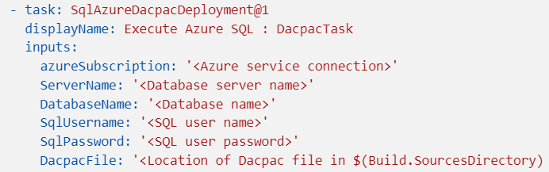
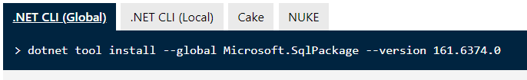
Deployment

Slide 19
Deployment
sqlpackage CLI
dotnet tool install microsoft.sqlpackage –g
sqlPackage /Action:Publish /SourceFile:”DacpacDemo.dacpac" /TargetConnectionString:"Server=(localdb)\mssqllocaldb;Initial Catalog=DacpacDemo;Integrated Security=true;Encrypt=False"
Azure DevOps Task (also a similar one on GitHub)
Demo (sqlpackage)

Slide 20

Why .dacpac?
Ensure high quality and consistent SQL schema
Desired state configuration
Fits into CI/CD workflows
Publish magic!

Slide 21
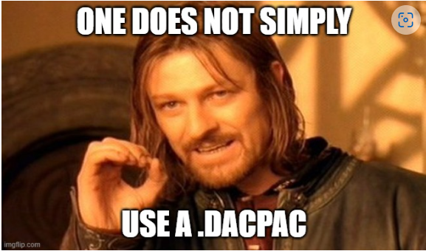
Q & A

Slide 22
Q & A
Handling destructive schema changes?
How do I ”seed data” to my database using a .dacpac?
I use Postgres / Oracle /MySQL – can I use this?
Does it work on Azure SQL Databases? Sharing parts of a database (f.ex. monitoring) ?
What if my db has dependencies on other database?
How would this work with EF Core?
How about .NET Aspire?

